Slide 1
THE APPROACH AND CONTRUBITION OF FEANI / ENGINEERS EUROPE TO THE UN SUSTAINABILITY GOALS Position Paper
FEANI Position Paper on the UN SDGs
1

Slide 2
About FEANI - Féderation Européenne d’Associations Nationales d’Ingénieurs
FEANI, founded in 1951, is the European umbrella Organization representing the interests of over 6 million professional engineers in Europe. It unites national engineering associations from 33 countries of the European Higher Education Area (EHEA), bringing together more than 350 national engineering associations, all of which are recognised in their countries as the representatives of the engineering profession at national level.
FEANI Position Paper on the UN SDGs

Slide 3
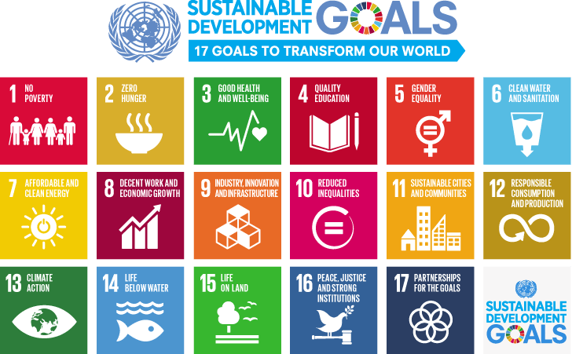
About the United Nations Sustainable Development Goals (UN SDGs)
FEANI has made it one of its major tasks to strive for the achievement of the UN SDGs.
For this purpose it has developed a position paper to amplify the role engineering and technology will play in achieving a more sustainable global economy and future way of life.
FEANI Position Paper on the UN SDGs

Slide 4
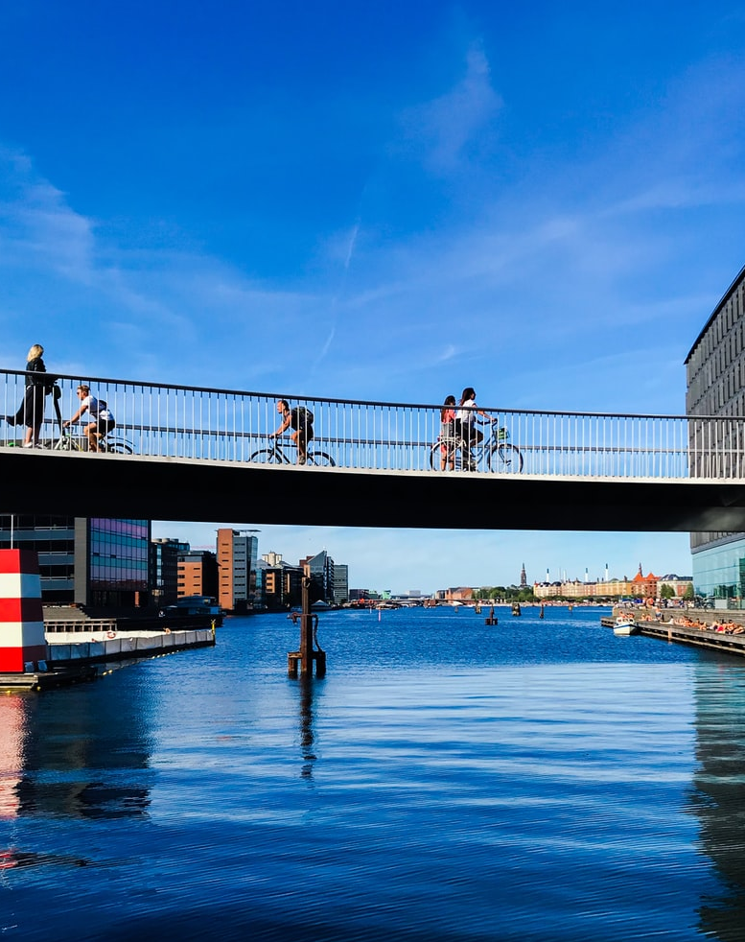
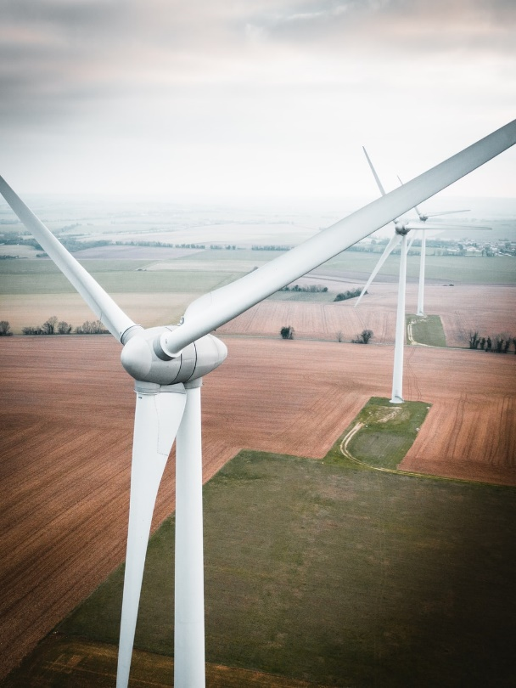
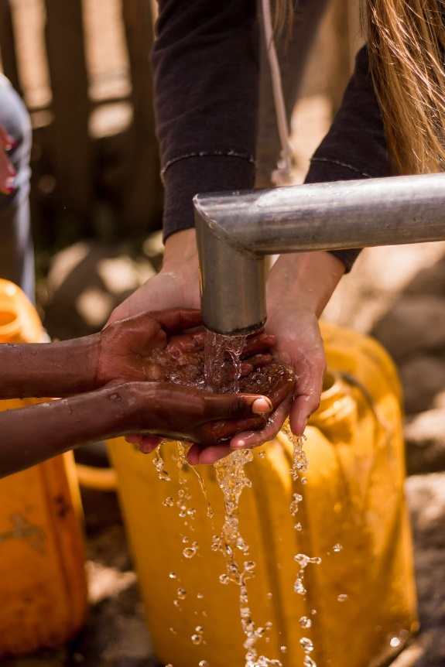
About the role of Engineers and Engineering
SDG 6:
Engineers and technology are essential to providing a sustainable, affordable, and reliable supply of clean water and of area-wide sewage water treatment.
SDG 7:
Engineers are essential when it comes to the conception and realization of alternative energy sources and an energy-efficient infrastructure.
SDG 9:
Engineers are essential when it comes to keeping industry innovative and competitive and to keep the public infrastructure on a high level of quality and efficiency, thus stimulating investments.
SDG 11:
Engineers are essential for the development and realization of solutions to the challenges of increasingly urbanized societies, such as sustainable housing, logistics, urban gardening, individual and public mobility, etc.
FEANI Position Paper on the UN SDGs

Slide 5
About the role of Engineers and Engineering
Embracing sustainability represents great opportunities for Europe :
Companies may come up with new services/products, creating unique selling points; in addition, they may redesign their own internal processes resulting in a positive image and possible cost reductions.
Individual engineers may develop new profiles and become experts in certain fields, answering to an increasing demand for expertise in the field of sustainability.
Engineering associations may increase their attractiveness for young people, who identify themselves with sustainability, while at the same time experienced engineers may be looking for a platform to disseminate their knowledge and experience.
FEANI Position Paper on the UN SDGs

Slide 6
About what Engineering Associations can do
Sustainability is by definition an engineering topic :
Engineers and Engineering Associations will take an active part in the discussions and actions for achieving sustainability.
Engineers will not shy away from public engagement and participate in the decision-making processes.
Engineering Associations will take the lead in attracting young people to engage in science and technology.
Future engineers must be trained with a multidisciplinary approach and “know how” in order to deploy their technical knowledge and their abilities to shape the future.
FEANI Position Paper on the UN SDGs

Slide 7
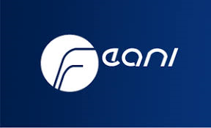
Examples of Engineering Associations involved with the SDGs
I. The FEANI Working Group SDGs launched a series of webinars during 2021, e.g. on SDG 6 “Clean Water and Sanitation”. Different experts from industry provided insights on how their companies contribute to the pursuit of SDG 6.
II. The UK Engineering Council reviewed standards for education and competences in August 2020, increasing content and requirements for sustainable practice and knowledge of sustainable work.
III. The Association of German Engineers VDI, made the “1.5 degrees” goal a major theme of its biannual German Engineering Day (DIT) in May 2021, providing a public platform for politicians, companies, civil society and individuals to discuss and exchange ideas on sustainability.
FEANI Position Paper on the UN SDGs

Slide 8
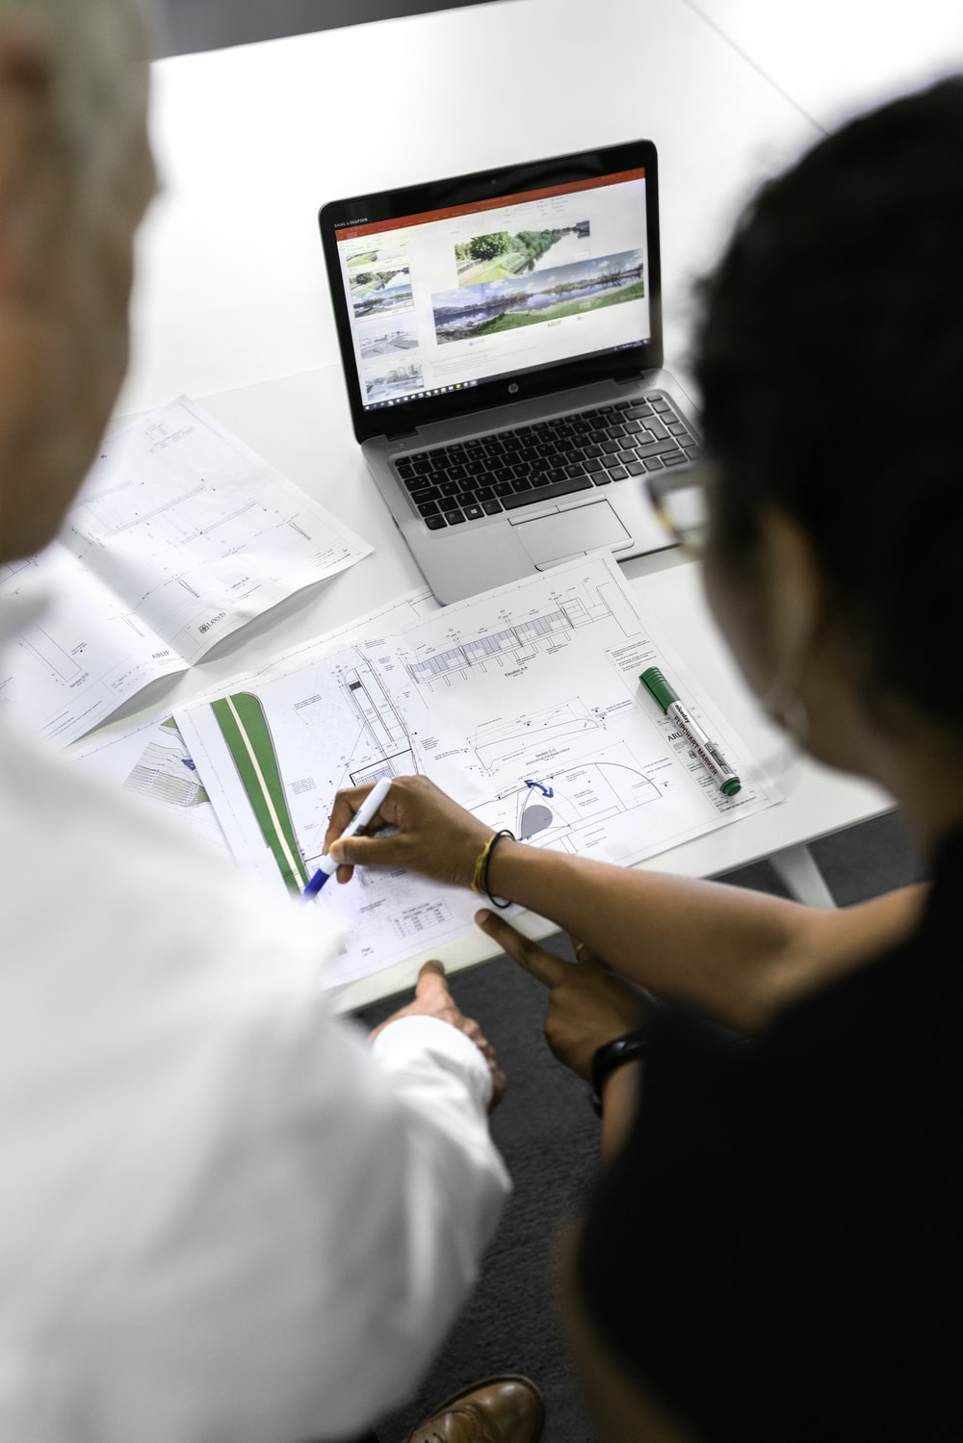
About the way ahead – some suggestions
Engineering Associations can provide expert support in areas such as :
Engineering Education : in collaboration with educational institutions, adopt programs to include trends (digitalization, international and interdisciplinary approaches) which enable young professionals to successfully deal with the challenges in achieving the UN SDGs.
Continuing Professional Development : Engineering education must become “life-long” as the skills and mindsets required will evolve. Engineering Associations are actively supporting engineers in keeping up to date with the current requirements. This will be intensified in the future.
FEANI Position Paper on the UN SDGs

Slide 9
About the way ahead – some suggestions
Engineering associations can provide expert support in areas such as :
Networking and Advocacy: Engineering Associations are exchange platforms for businesses, politicians and civil society. Engineers must use these platforms to communicate sustainable development objectives and goals. Engineers must better explain the relevance of their work. Engineers can provide expert advice to political decision-making bodies, e. g. to the European Commission, as political decisions must be based on solid scientific data.
Recruitment and Support: Engineering Associations have networks, are impartial and deliver high quality of work. They are perfectly suited to recruit and activate the expertise that exists within the engineering community. They can function as a platform to mobilize knowledge in support of the SDGs’ achievement.
FEANI Position Paper on the UN SDGs

Slide 10
Conclusion
Achieving the UN SDGs will be an up-hill struggle, a marathon, not a sprint.
Engineers will play a vital and crucial role in making human society more sustainable.
Engineers are accepting this challenge with humility and dedication.
FEANI Position Paper on the UN SDGs

