Slide 1
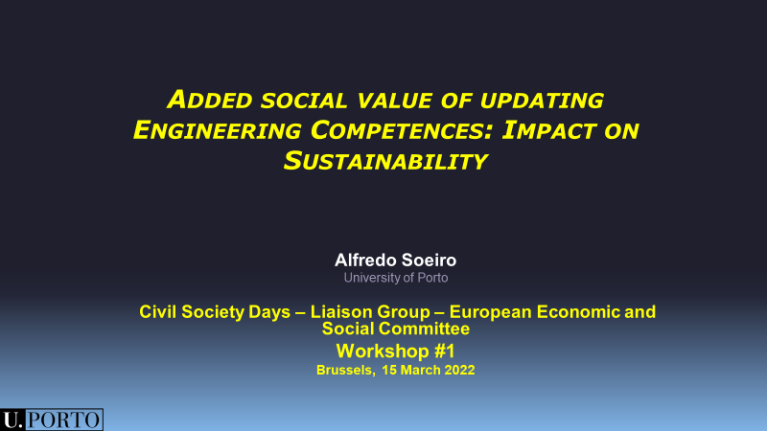
"Added social value of updating Engineering Competences: Impact on Sustainability"

Slide 2
"Added social value of updating Engineering Competences: Impact on Sustainability"

Slide 3
"Added social value of updating Engineering Competences: Impact on Sustainability"

Slide 4
"Added social value of updating Engineering Competences: Impact on Sustainability"

Slide 5
"Added social value of updating Engineering Competences: Impact on Sustainability"

Slide 6
"Added social value of updating Engineering Competences: Impact on Sustainability"

Slide 7
"Added social value of updating Engineering Competences: Impact on Sustainability"

Slide 8
"Added social value of updating Engineering Competences: Impact on Sustainability"

Slide 9
"Added social value of updating Engineering Competences: Impact on Sustainability"

Slide 10
"Added social value of updating Engineering Competences: Impact on Sustainability"

Slide 11
"Added social value of updating Engineering Competences: Impact on Sustainability"

Slide 12
"Added social value of updating Engineering Competences: Impact on Sustainability"

Slide 13
"Added social value of updating Engineering Competences: Impact on Sustainability"

Slide 14
"Added social value of updating Engineering Competences: Impact on Sustainability"

Slide 15
"Added social value of updating Engineering Competences: Impact on Sustainability"

